Slide 1
Defensive Security Project
by: Room 3
John Mercer
Josh Newman
Notes:
John

Slide 2
Table of Contents
This document contains the following resources:
Monitoring Environment
Attack Analysis
Project Summary & Future Mitigations
Notes:
John

Slide 3

Monitoring Environment
‹#›
Notes:
John

Slide 4
Scenario
We were provided logs from a Windows server and an Apache web server from a time with normal activity.
We used this data to set up Splunk reports, alerts, and dashboards to look for unusual activity.
We were provided with logs from an attack.
We examined these attack logs using our reports, alerts, and dashboards to see if the attack(s) were detected.
We set up additional Website Monitoring on the website.
Notes:
John

Slide 5
Website Monitoring
‹#›
Notes:
Josh

Slide 6
Website Monitoring
This Add on App allows us to see real time information about our website such as downtime and response time. This allows us to see in real time if we are under attack from our rivals. Since we frequently see DDOS attacks on our site this add on will be very helpful.
Notes:
Josh

Slide 7
Website Monitoring
During a DDOS attack you can see high response times and website downtime due to the nature of the attack, with this add on we can get notified via email about the attack as soon as it is detected by the add on.
Notify us about network issues unrelated to an attack.
Notes:
Josh

Slide 8
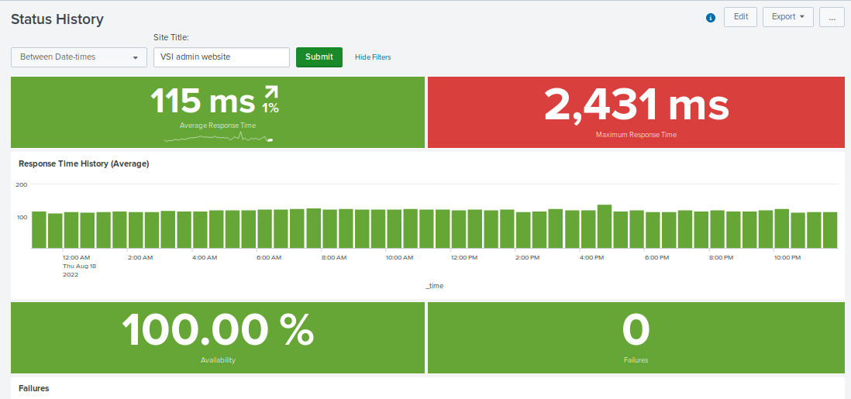
Website Monitoring
Notes:
Josh

Slide 9
Logs Analyzed
Windows Logs
Apache Logs
1
2
Windows server security logs that show activity on user and computer accounts, such as:
User account creation or deletion
User account changes
User account logged on
User account password reset attempts
User accounts locked out
Apache web server logs indicating:
what clients were connecting
what the client’s IP address was
what method they used
what URI they requested
what the server’s response was
Notes:
Josh

Slide 10
Windows Logs
‹#›
Notes:
Josh

Slide 11
Reports—Windows
Designed the following Reports:
Report Name | Report Description
VSI-WindowsLogs-severity_counts | Count of all events grouped by severity. Can be used to show if numbers go up.
VSI-WindowsLogs-success_failure_rate | Counts of successful and failure events. Can be used to show increase in failures.
VSI-WindowsLogs_signature timechart | Shows history of events over time, identified by event signature.
VSI-WindowsLogs_user timechart | Shows history of events over time, identified by user.
Notes:
Josh

Slide 12
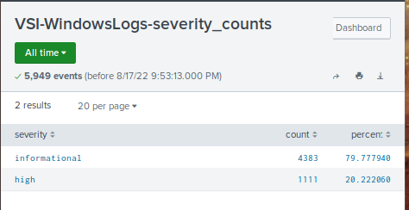
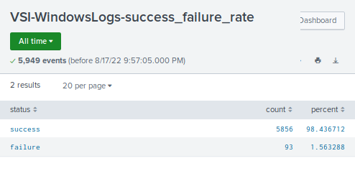
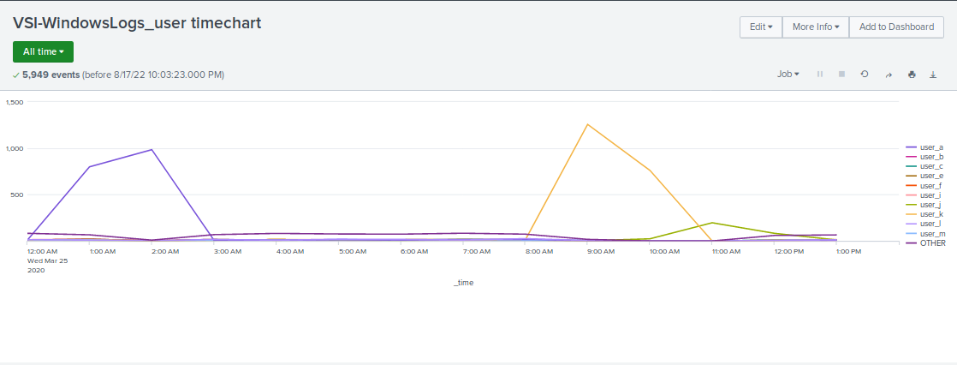
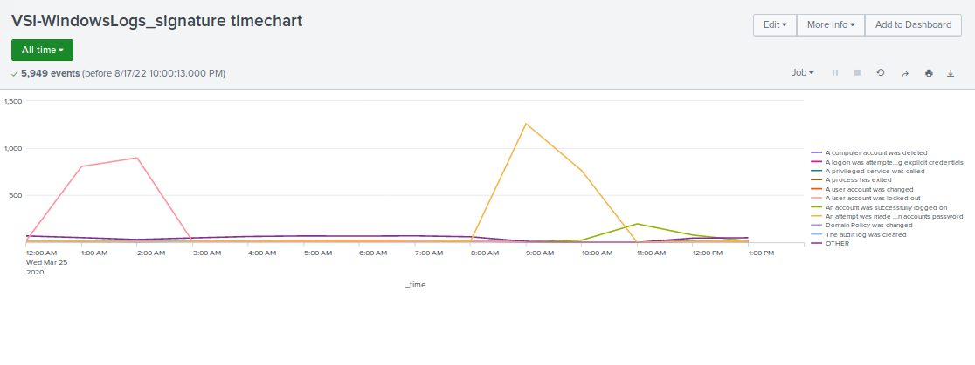
Images of Reports—Windows
Notes:
Josh
Although the two reports with counts can help, they do require comparison over time to be useful. The two timechart reports, created for the dashboard, do show this and are useful for showing items of concern.

Slide 13
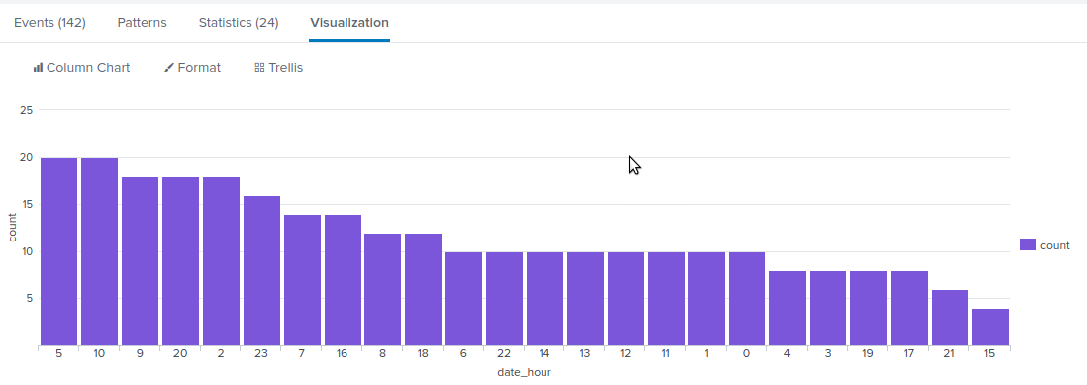
Alerts—Windows
Designed the following alerts:
Alert Name | Alert Description | Alert Baseline | Alert Threshold
VSI-WindowsLogs_high hourly failure rate | Monitors count of all failure events | 20 events/hour | 30 events/hour
JUSTIFICATION: Analysis of “normal” data showed a hourly maximum of 20 events. Threshold was set at 150% of this.
Notes:
Josh
This alert would have triggered at 8:00 am for 35 events.

Slide 14
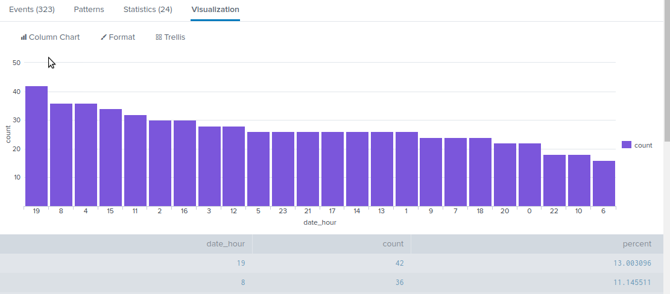
Alerts—Windows
Designed the following alerts:
Alert Name | Alert Description | Alert Baseline | Alert Threshold
VSI-WindowsLogs_high successful logon rate | Monitors for high number of account logons | 40 events/hour | 60 events/hour
JUSTIFICATION: Analysis of “normal” data showed a hourly maximum of 20 events. Threshold was set at 150% of this.
Notes:
Josh
This alert would have triggered at 11:00 am for 196 events.

Slide 15
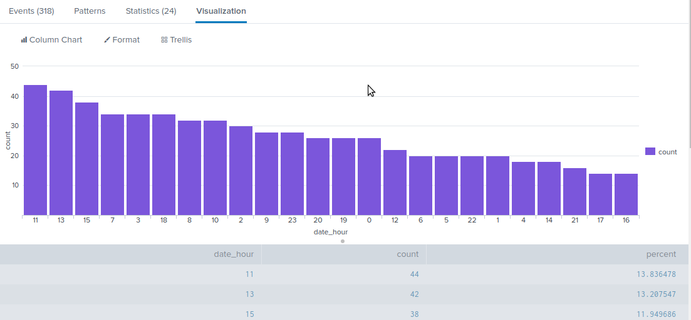
Alerts—Windows
Designed the following alerts:
Alert Name | Alert Description | Alert Baseline | Alert Threshold
VSI-WindowsLogs_high account deletion rate | Monitors for high number of account deletions | 44 events/hour | 65 events/hour
JUSTIFICATION: Analysis of “normal” data showed a hourly maximum of 20 events. Threshold was set at ~150% of this.
Notes:
Josh
This alert would not have triggered. It may not be a useful metric to monitor.

Slide 16
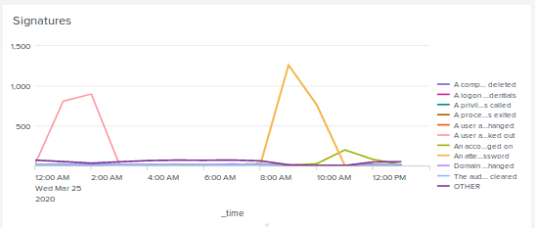
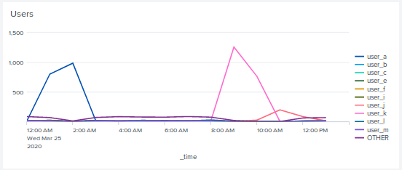
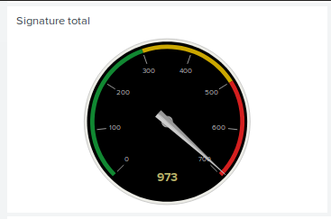
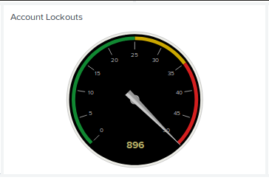
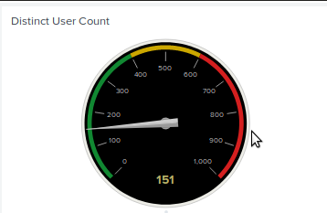
Dashboards—Windows
Notes:
Josh
Timecharts as seen before in reports. The dials were set up to monitor activity on an hourly basis. The Signature total and Account Lockouts are both showing when they would have maxed out. The Distinct User Count dial never left the green and is probably not a good metric.

Slide 17
Apache Logs
‹#›
Notes:
John

Slide 18
Reports—Apache
Designed the following reports:
Report Name | Report Description
VSI-ApacheLogs-Methods | counts of various HTTP methods
VSI-ApacheLogs-top referrer domains | top ten domains referring to VSI site
VSI-ApacheLogs-count by status | counts by HTTP status for requests
VSI-ApacheLogs-top 10 URIs | top ten URI’s requested
Notes:
John

Slide 19
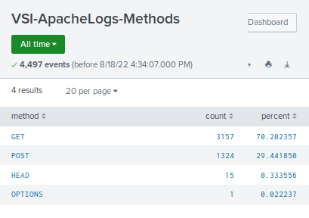
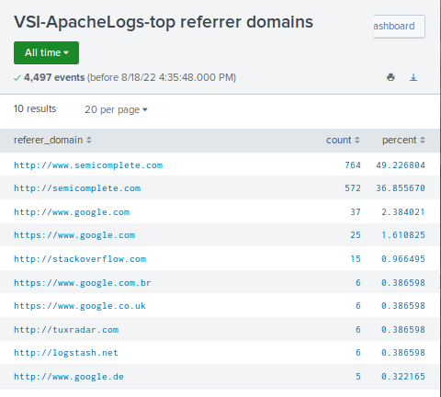
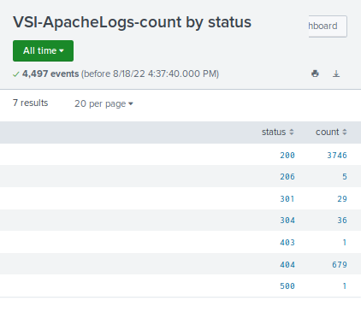
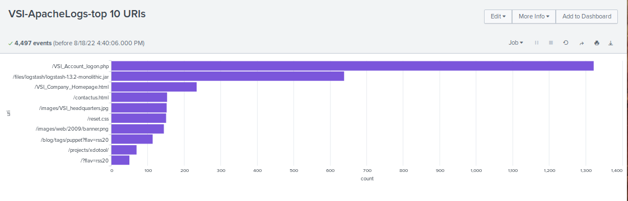
Images of Reports—Apache
Notes:
John

Slide 20
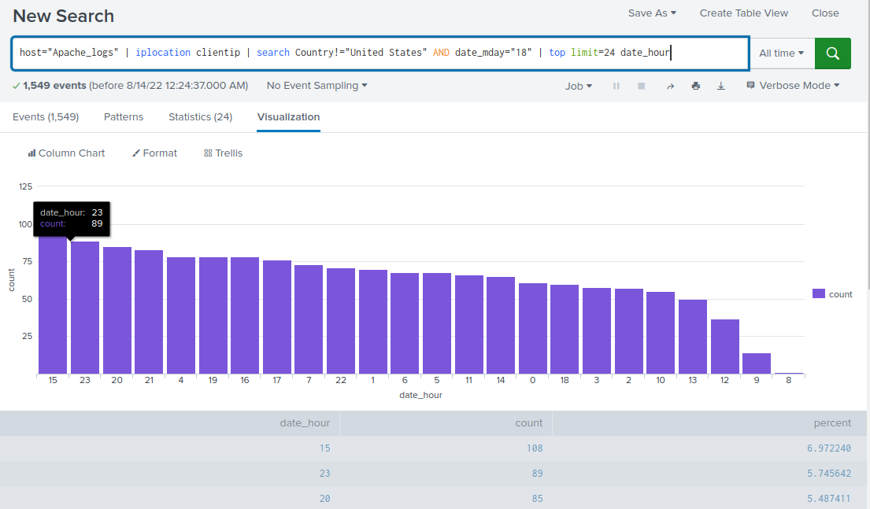
Alerts—Apache
Designed the following alerts:
Alert Name | Alert Description | Alert Baseline | Alert Threshold
VSI-ApacheLogs-high non-US client count | Triggers if hourly count of requests from outside US is too high | 120 | 180
JUSTIFICATION: Analysis of “normal” data showed a hourly maximum of 120 events. Threshold was set at 150% of this.
Notes:
John

Slide 21
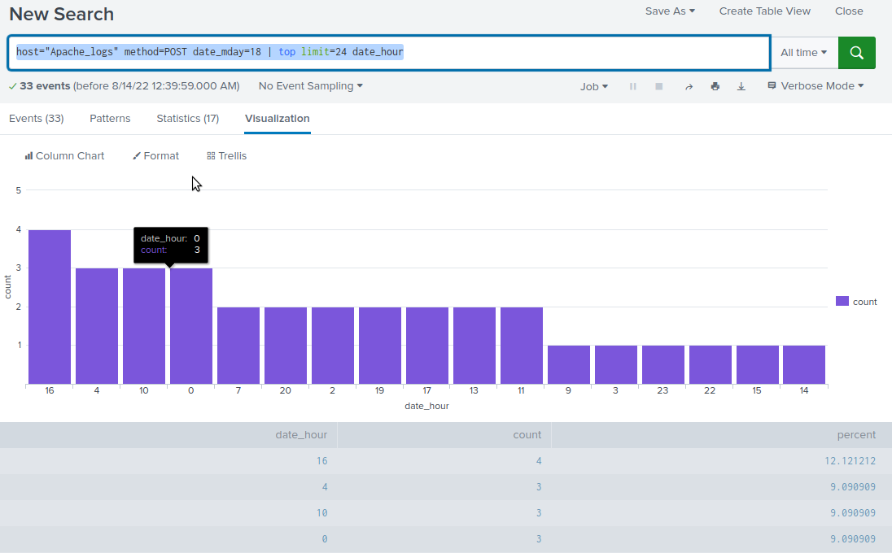
Alerts—Apache
Designed the following alerts:
Alert Name | Alert Description | Alert Baseline | Alert Threshold
VSI-ApacheLogs-high post count | Alerts if hourly count for POST method is too high | 7 | 12
JUSTIFICATION: Analysis of “normal” data showed a hourly maximum of 7 events. Threshold was set at 170% of this, since the numbers are quite low, to prevent false positives.
Notes:
John

Slide 22
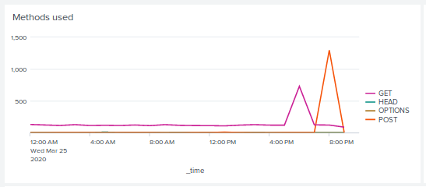
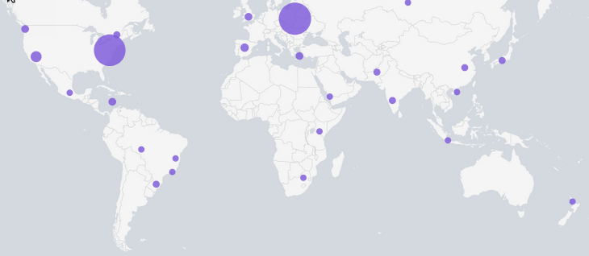
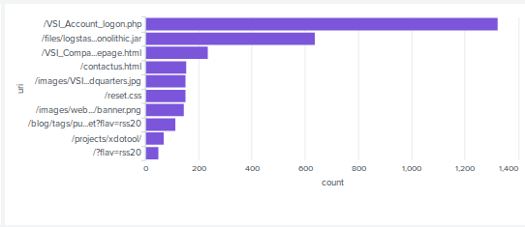
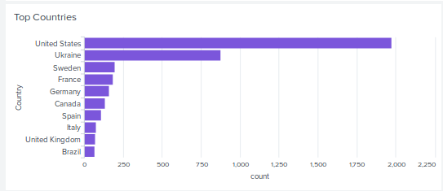
Dashboards—Apache
Notes:
John

Slide 23
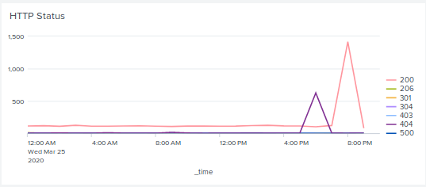
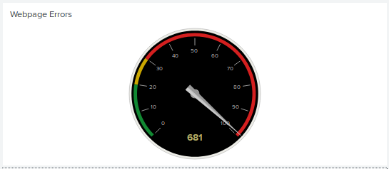
Dashboards—Apache
Notes:
John

Slide 24
Attack Analysis
‹#›
Notes:
John

Slide 25
Attack Summary—Windows
Summarize your findings from your reports when analyzing the attack logs.
The report for the event severity does show the number of high events increased. But it doesn’t show what the events were.
The report for the number of failed events doesn’t show significant change in the total number and may not be useful here.
Notes:
Josh

Slide 26
Attack Summary—Windows
Summarize your findings from your alerts when analyzing the attack logs. Were the thresholds correct?
The alert for a high hourly rate of failure triggered and may be useful even if the report for total number is not.
The alert for a high hourly rate for successful logins triggered and may be useful.
The alert for a high hourly rate of account deletion did not trigger. The recent attack did not use this method, but others might.
Notes:
Josh

Slide 27
Attack Summary—Windows
Summarize your findings from your dashboards when analyzing the attack logs.
The timecharts for events and user activity were useful to spot the unusual activity of the attack.
The dials of events per hour and lockouts per hour, while useful, would require real-time monitoring to alert on an attack. Perhaps a different visualization would work better.
The dial for number of user accounts did not prove useful as changing the number of accounts was not part of this attack.
Notes:
Josh

Slide 28
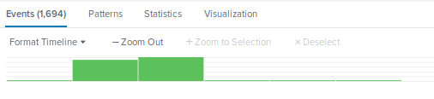
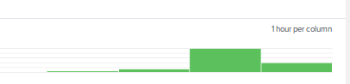
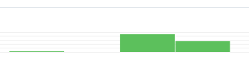
Screenshots of Attack Logs
The account user_a was locked out over 1400 times between 1:00 am and 2:00 am.
The account user_j was successfully logged on almost 300 times between 10:00 am and 1:00 pm.
An attempt was made to reset the password for user_k over 2000 times between 9:00 am and 11:00 am
Notes:
Josh

Slide 29
Attack Summary—Apache
Summarize your findings from your reports when analyzing the attack logs.
There was an unusually high number of POSTs indicating a potential attack.
There was no significant change in the top referrer domains.
There was a significant increase in the number of 404 response codes, indicating a potential attack, such as a DoS.
Notes:
John

Slide 30
Attack Summary—Apache
Summarize your findings from your alerts when analyzing the attack logs. Were the thresholds correct?
The alert for a high number of non-US clients triggered and may be a sign of attack, depending on the legitimate client base.
The alert for high POST activity triggered and could be a sign of attack, depending on the web site design.
Notes:
John

Slide 31
Attack Summary—Apache
Summarize your findings from your dashboards when analyzing the attack logs.
The timechart for methods was useful to spot attacks as two spikes appeared.
The map for clients was useful to identify the locations for an attack. The corresponding country list confirmed this.
The top URI list helped show that the logon page was seeing high traffic and may be an indicator of attack.
The timechart for HTTP status looks similar to the methods but shows the server response and has spikes in successes and failures. The corresponding dial for number of failures shows this as well.
Notes:
John

Slide 32
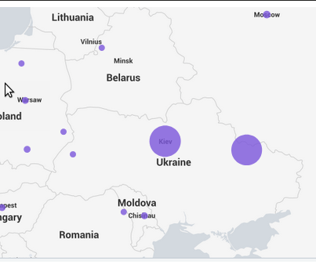
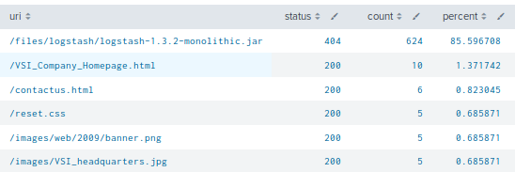
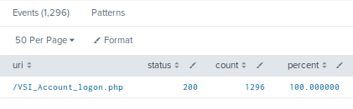
Screenshots of Attack Logs
Map drill down shows the attack originated in two cities in Ukraine.
There were two attacks:
A lot of GET requests at 6 PM for a specific URI that resulted in a 404 error message.
A lot of POST requests at 8 PM to the logon page that had a successful response.
Notes:
John

Slide 33
Summary and Future Mitigations
‹#›
Notes:
John

Slide 34
Project 3 Summary
What were your overall findings from the attack that took place?
The Windows environment was attacked 3 times, but it does not appear significantly impacted apart from 3 specific user accounts.
The website was attacked 2 times but it does not appear significantly impacted.
To protect VSI from future attacks, what future mitigations would you recommend?
Make sure access to the Windows environment from the outside world (e.g. VPN) is properly controlled and isolated from the web servers.
Make sure the web servers are powerful enough to handle a DoS attack.
Notes:
John

